Slide 1
WELD CLASSIFICATION
INTELLIGENT SYSTEMS ENGINEERING
Abhisek Panigrahi
Abhijit Nayak
Pratap Roy Choudhury
Shubham Mohapatra
INDIANA UNIVERSITY BLOOMINGTON

Slide 2
Agenda
Introduction
Dataset
Approach
Result
Conclusion

Slide 3
Introduction
Image Classification refers to the task of identifying, to what categories the images belong to. The categories/classes could be binary or multiple classes as well.
What is weld classification?
Difference between a good and bad welding

Slide 4
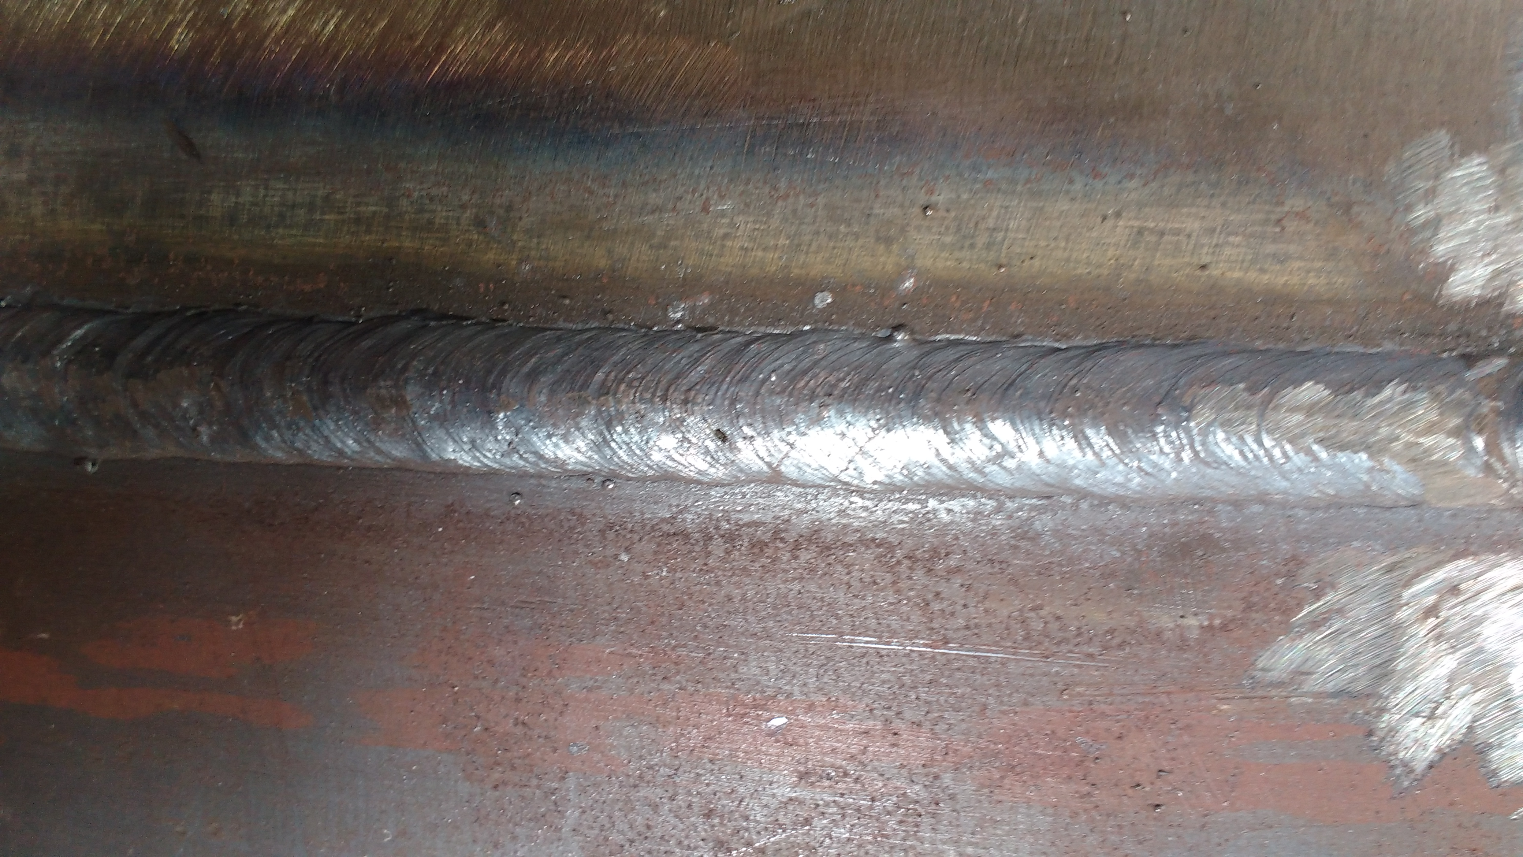
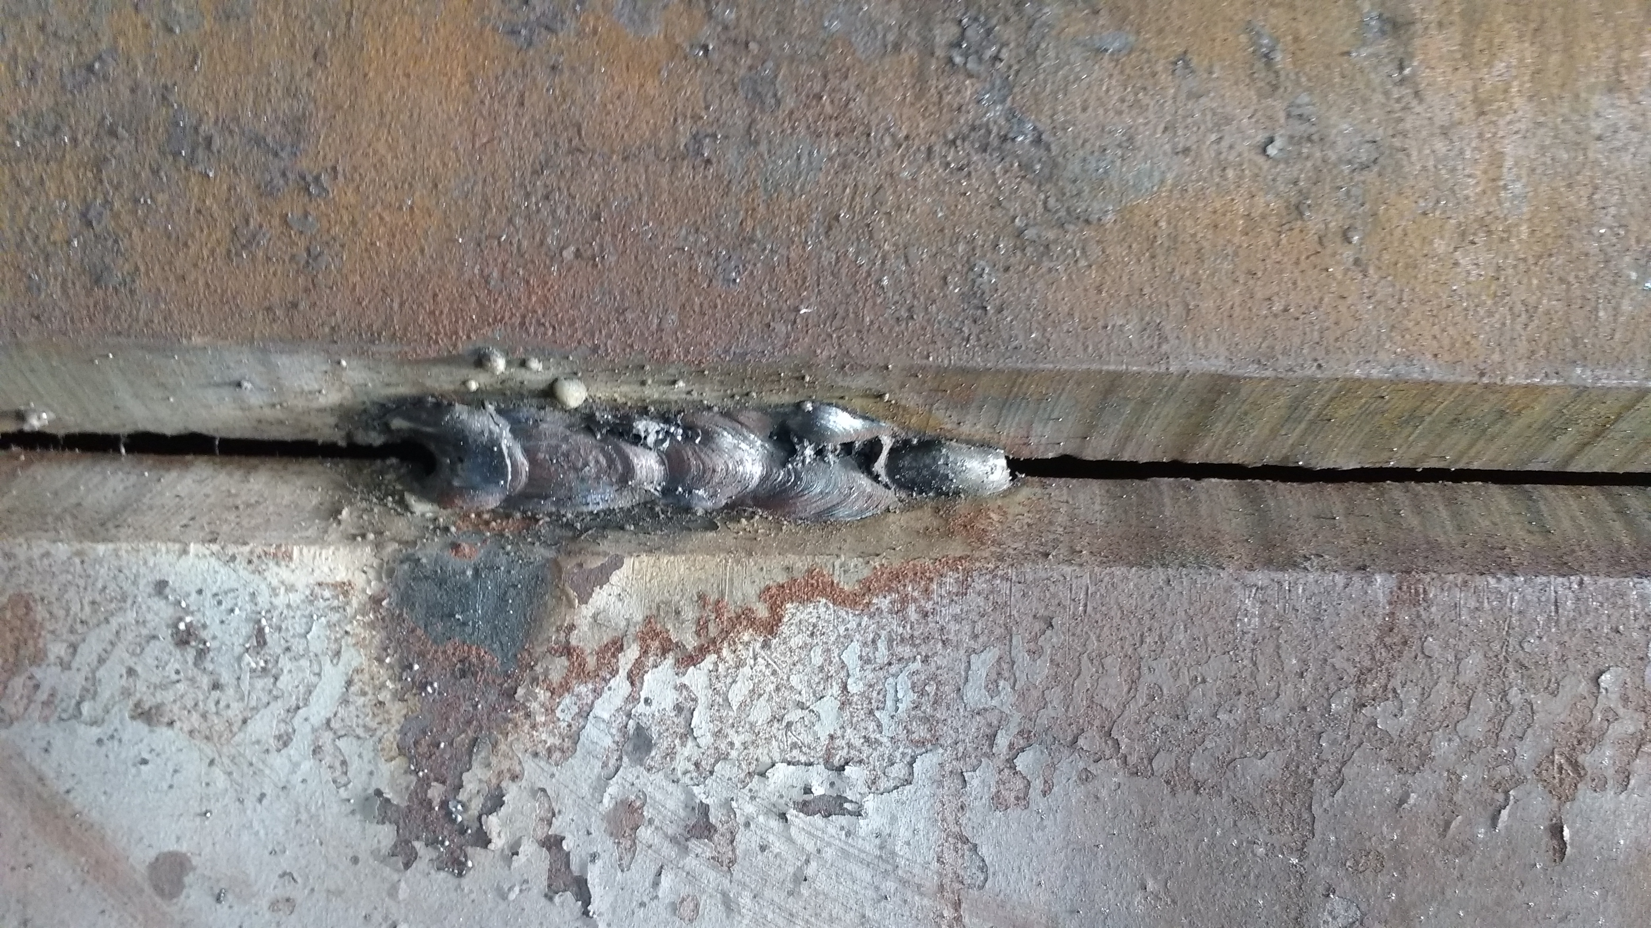
Dataset
Source: Kaggle
Train -> 8930 (after augmentation); 209 (before augmentation) . Augmented train good images -> 5430 and augmented train bad images -> 3500; balanced dataset.
Test dataset -> 30 images (15 good and 15 bad).
Good
Bad

Slide 5
Approach
START
Image Augmentation
Created Data Loaders
Transfer learning applied with Resnet 50 and ShufflenetV2
Optimizers used : Adam, SGD with momentum, RMSProp
Loss function : cross entropy loss
Inferences
Augmentation
Load Images
Transfer learning
Classification
END

Slide 6
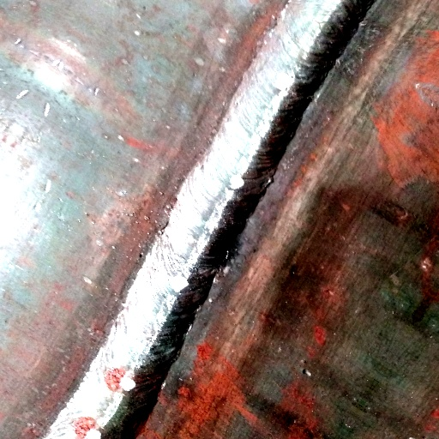
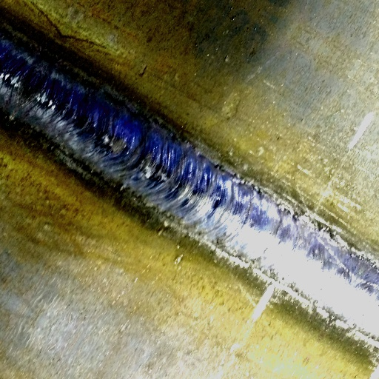
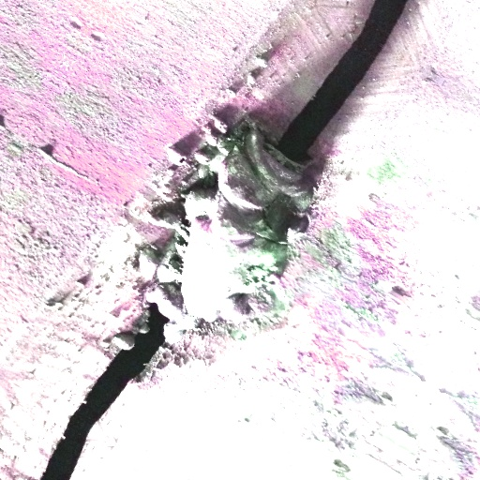
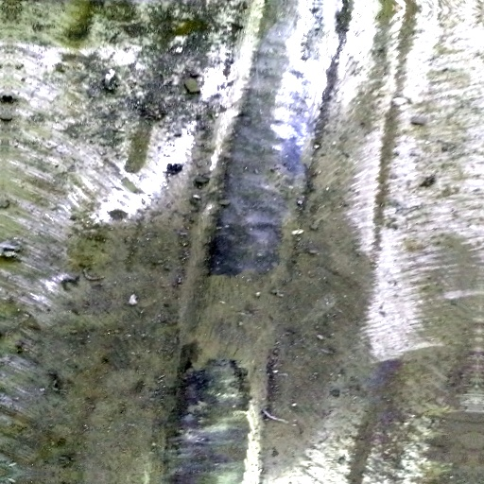
Augmentations
Good
Resize (128*128)
Rotation
Horizontal and Vertical Flip
ColorJitter with brightness and contrast
Bad

Slide 7
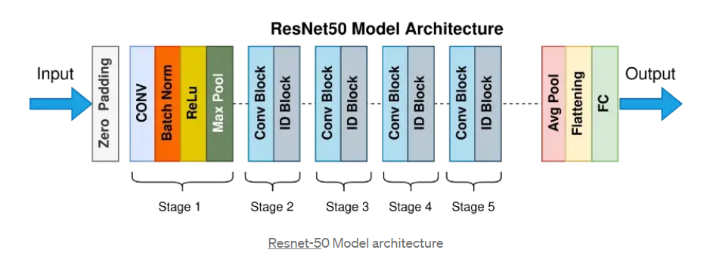
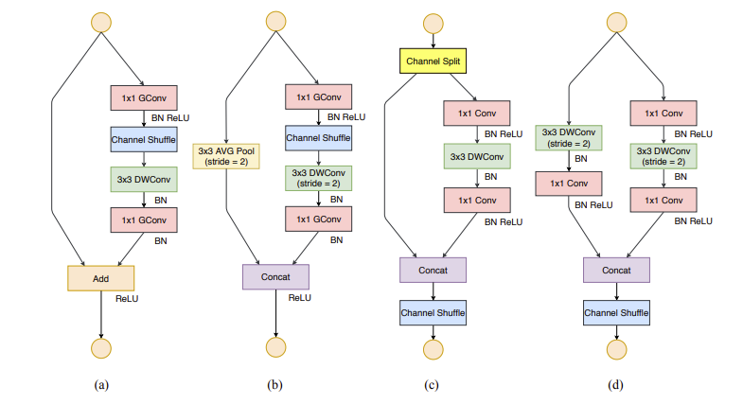
Models
Resnet50:
The 50-layer ResNet uses a bottleneck design for the building block. A bottleneck residual block uses 1×1 convolutions, known as a “bottleneck”, which reduces the number of parameters and matrix multiplications. [6]
ShuffleNetv2:
It builds upon ShuffleNet v1, which utilized pointwise group convolutions, bottleneck- like structures, and a channel shuffle operation. [5]

Slide 8
Optimizers
Adam
SGD with momentum
RMSProp
AdaBound

Slide 9
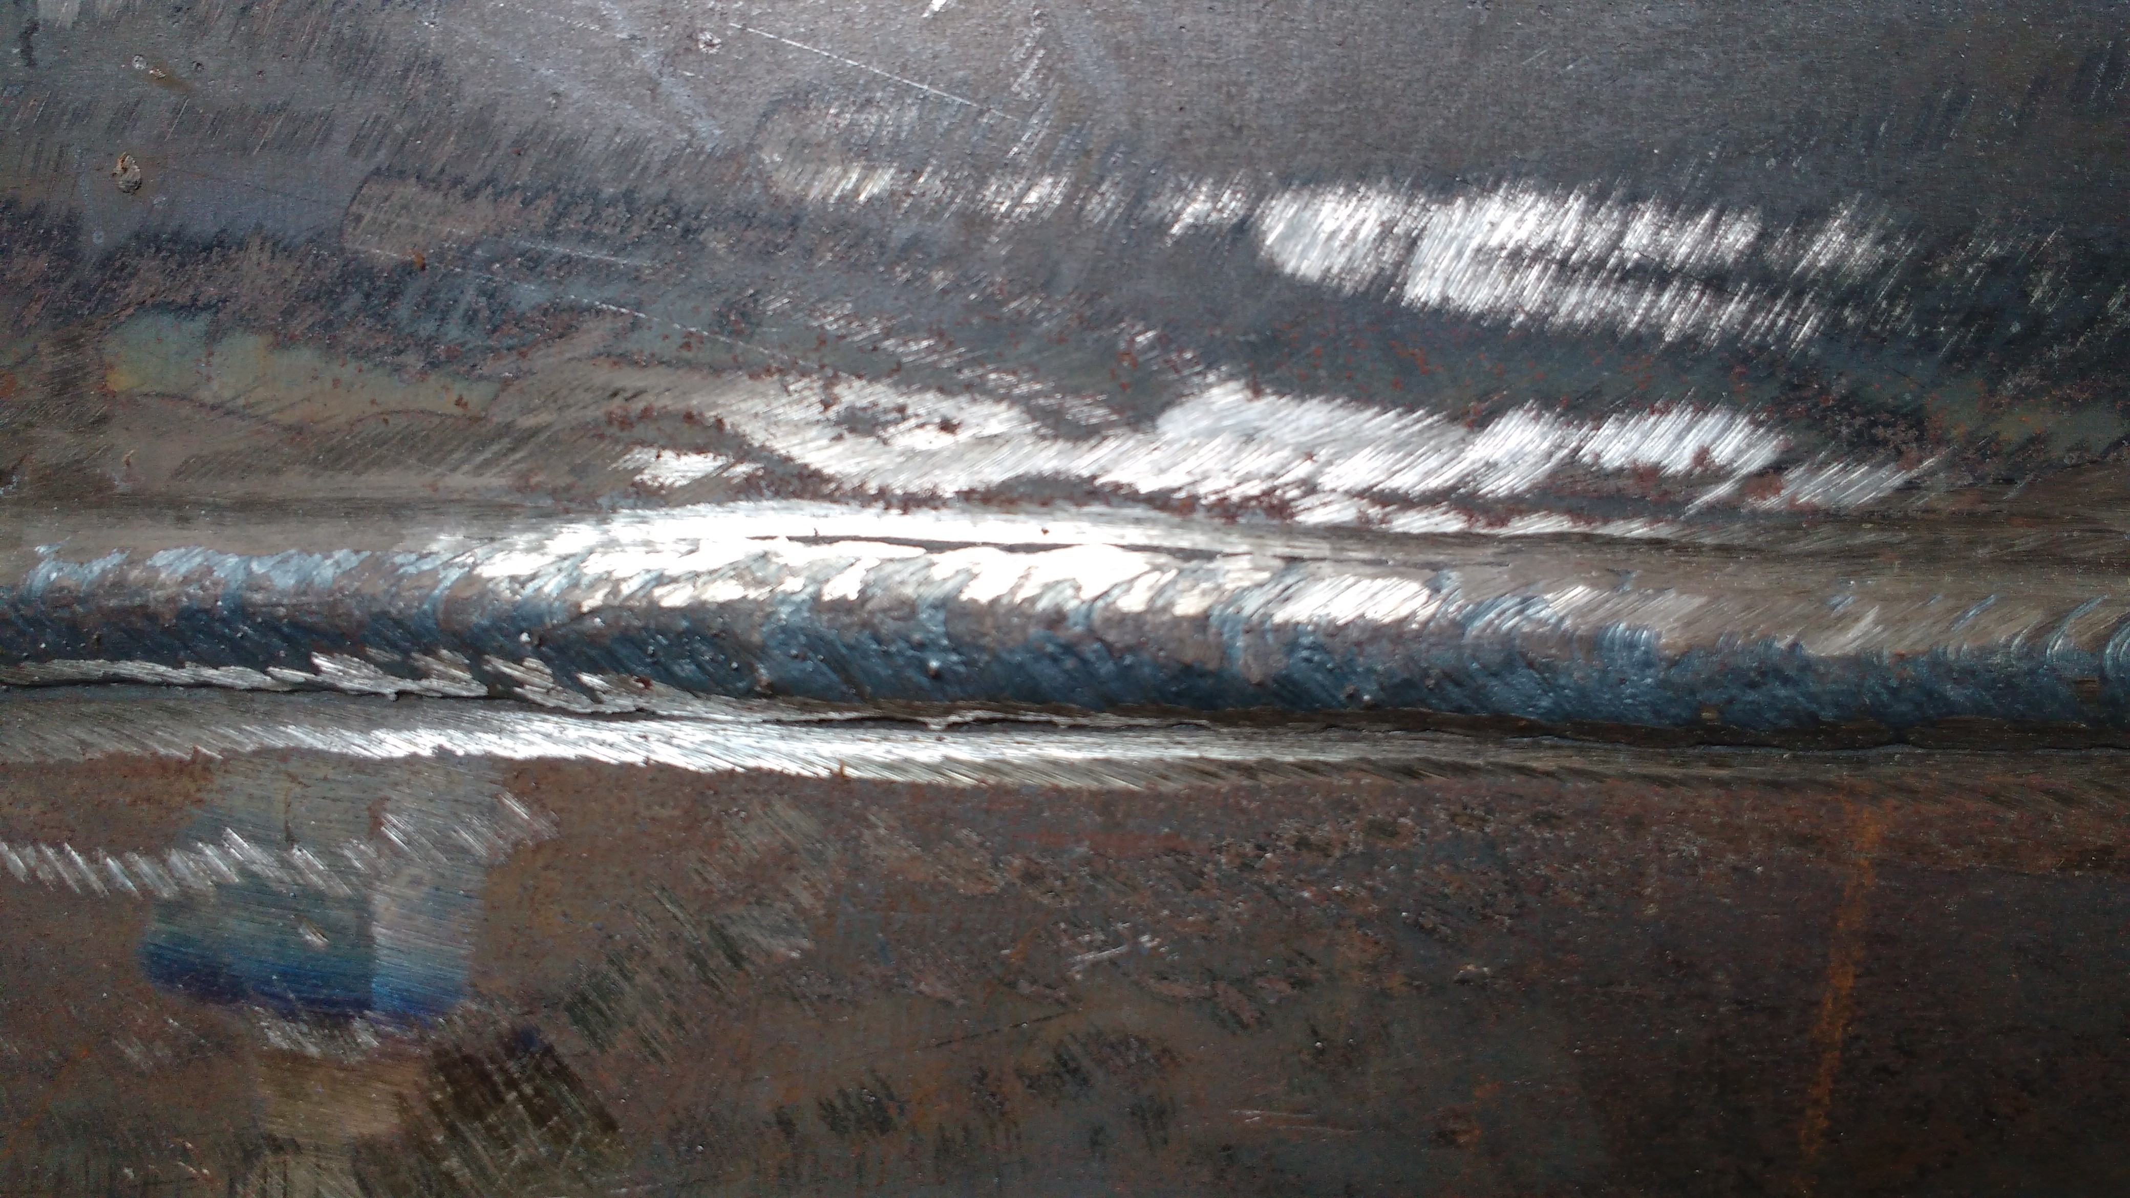
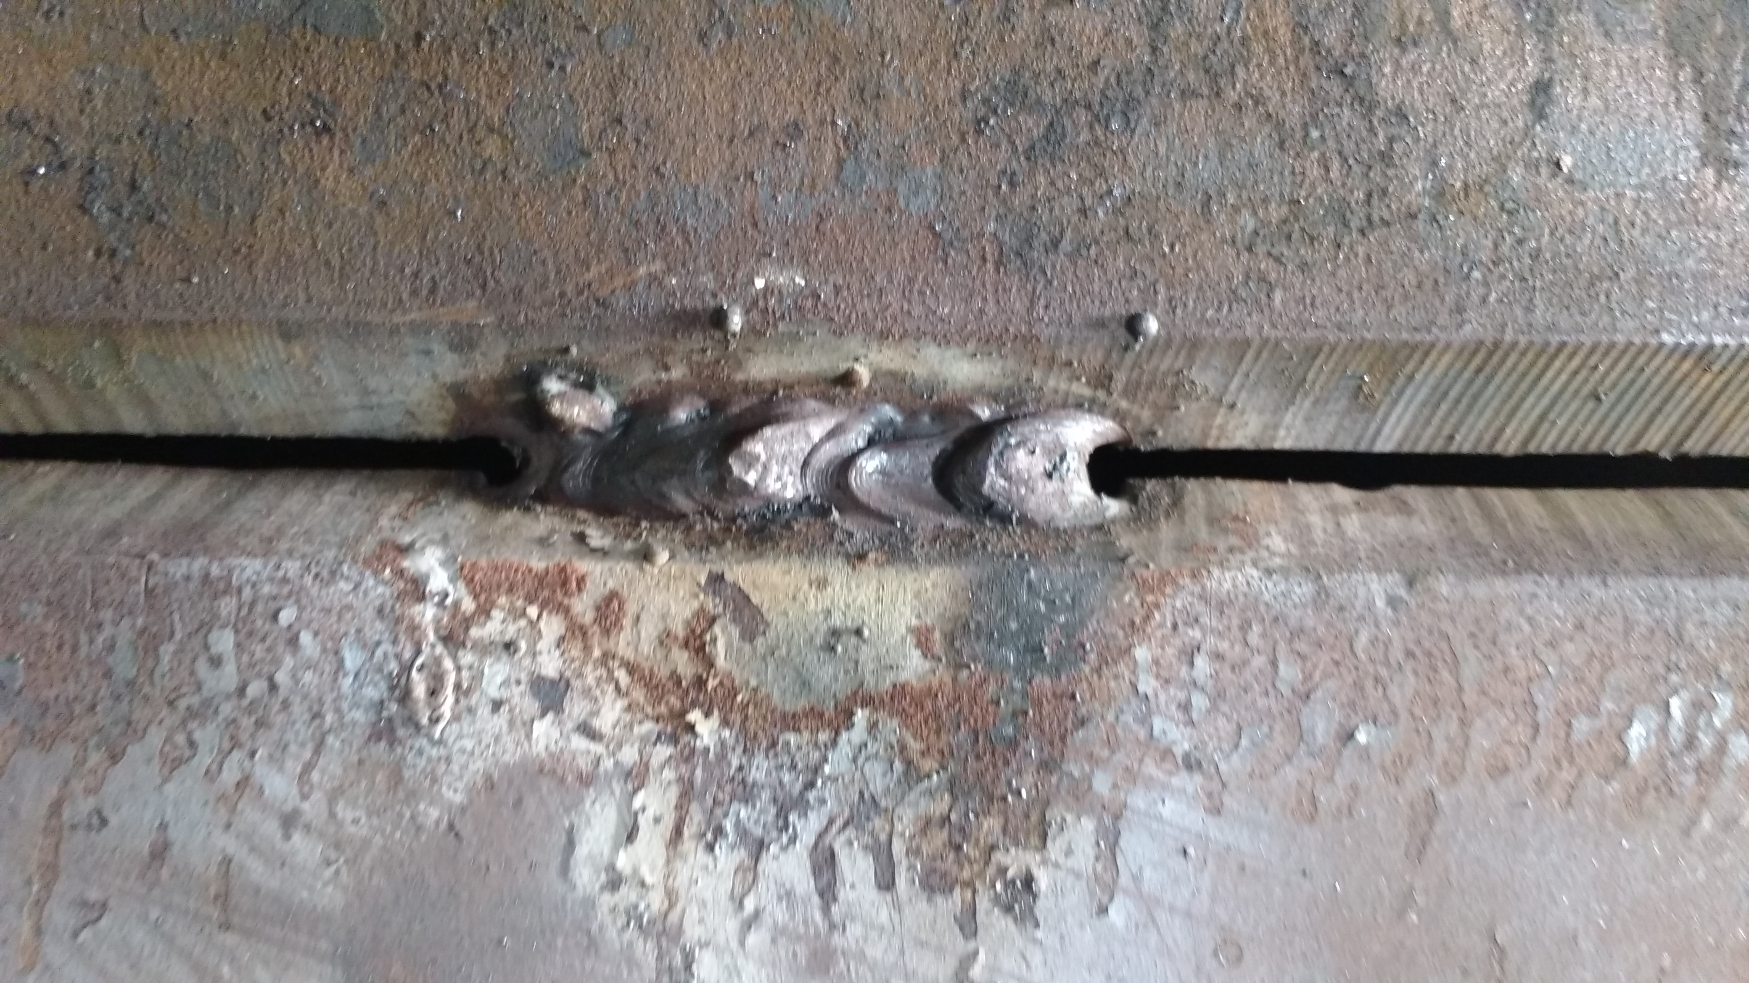
Results
Good and bad classification; model prediction with 1 image
Good
Bad

Slide 10
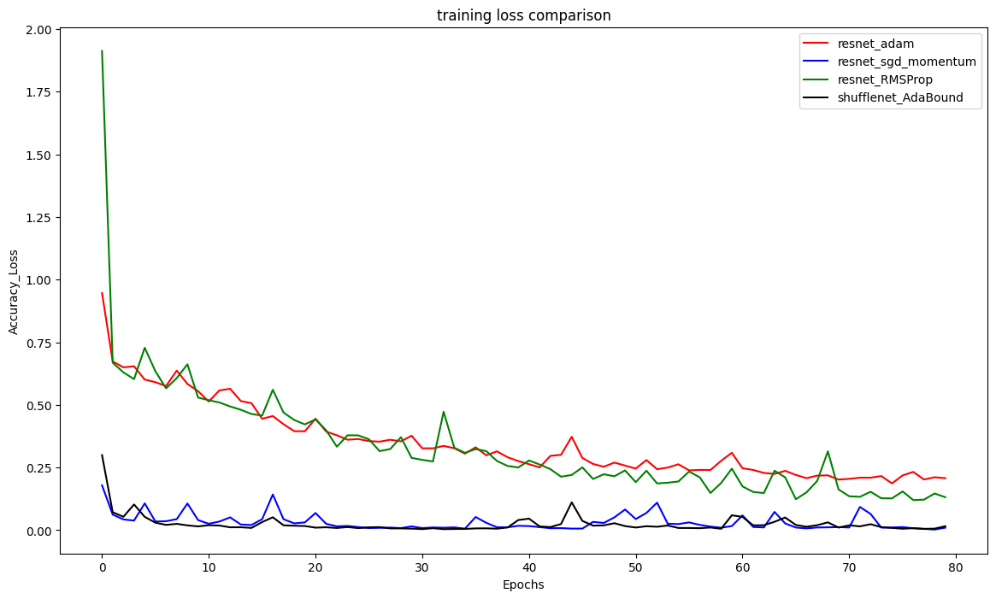
Results
Training loss Comparison of ResNet50 and ShuffleNetV2 with all optimizers

Slide 11
Results
AdaBound on ShuffleNet V2 and SGD (momentum) on ResNet50 have the best convergence rate.
ShuffleNet V2 with AdaBound has the fastest average training time per epoch.
ShuffleNet V2 with AdaBound has the best generalization with a 100% test accuracy.
Adam and RMSprop have the worst convergence and generalization rate.
Model (lr -> 0.01, batch size -> 32, epochs -> 20) | Optimizer | Training loss | Test Accuracy | Avg. Training Time per Epoch
Resnet 50 | Adam | 0.2 | 83% | 50 sec
Resnet 50 | SGD(momentum -> 0.5) | 0.007 | 96% | 55 sec
Resnet 50 | RMSProp | 0.14 | 73% | 1 minute
ShuffleNetV2 | AdaBound | 0.008 | 100% | 45 sec

Slide 12
Conclusion
Importance of automatic weld classification
We could achieve a very good accuracy with SGD with momentum and ShufflenetV2
We also saw that ShuffleNetV2 model with AdaBound optimizer had fastest training time, best convergence and generalization rate followed by ResNet50 with SGD (momentum) optimizer.

Slide 13
References
[1] Adrian Rosebrock. (2021, July 26). “PyTorch image classification with pre-trained networks.” https://pyimagesearch.com/2021/07/26/pytorch-image-classification-with-pre-trained-networks/
[2] Chiraz Ajmi, Juan Zapata, Sabra Elferchichi, Abderrahmen Zaafouri, Kaouther Laabidi. (2020, August 14). “Deep Learning Technology for Weld Defects Classification Based on Transfer Learning and Activation Features.” https://www.hindawi.com/journals/amse/2020/1574350/
[3] Emily Potyraj (Watkins). (2021, March 8). “4 Ways to Improve Class Imbalance for Image Data.” https://towardsdatascience.com/4-ways-to-improve-class-imbalance-for-image-data-9adec8f390f1
[4] EfficientNet by NVIDIA.
https://pytorch.org/hub/nvidia_deeplearningexamples_efficientnet/#:~:text=EfficientNet%20is%20an%20image%20classification,EfficientNet%2DWideSE%2DB4%20models
[5] https://arxiv.org/pdf/1807.11164v1.pdf
[6] https://datagen.tech/guides/computer-vision/resnet-50/

Slide 14


